Slide 1
SWAG Project
High School Recruitment

Slide 2
Agenda
Background
High School Landing Page
E-mails
Ads
Social Media
CCC Home Page

Slide 3
Background
CCC Social Web Action Group
Cross-campus representation
Our goal is to effectively communicate our messages through digital channels
Think strategically about communication: How do we support CCC priorities?
Coordinate among team members to ensure cross promotion of content, activities, and information for optimal awareness
Increase recall of messages
Reinforce core messages

Slide 4
High School Landing Page
http://www.clackamas.edu/NextStep/

Slide 5
E-mail to parents

Slide 6
E-mail to students

Slide 7
Facebook Ads
Parents
Students
Do the Math & Save Money
Starting a four year degree at Clackamas Community College saves thousands. Learn more.
Not Sure What To Do?
Clackamas Community College can guide you to a bright future after high school.

Slide 8
Google Adwords
Transferring colleges
College transfer credits
Community college transfer credits
Advanced career training
Career training programs
Applied career training
6 month career training
Two year career programs
Allied career training
Clackamas Community College
College classes for high school students
Classes in college

Slide 9
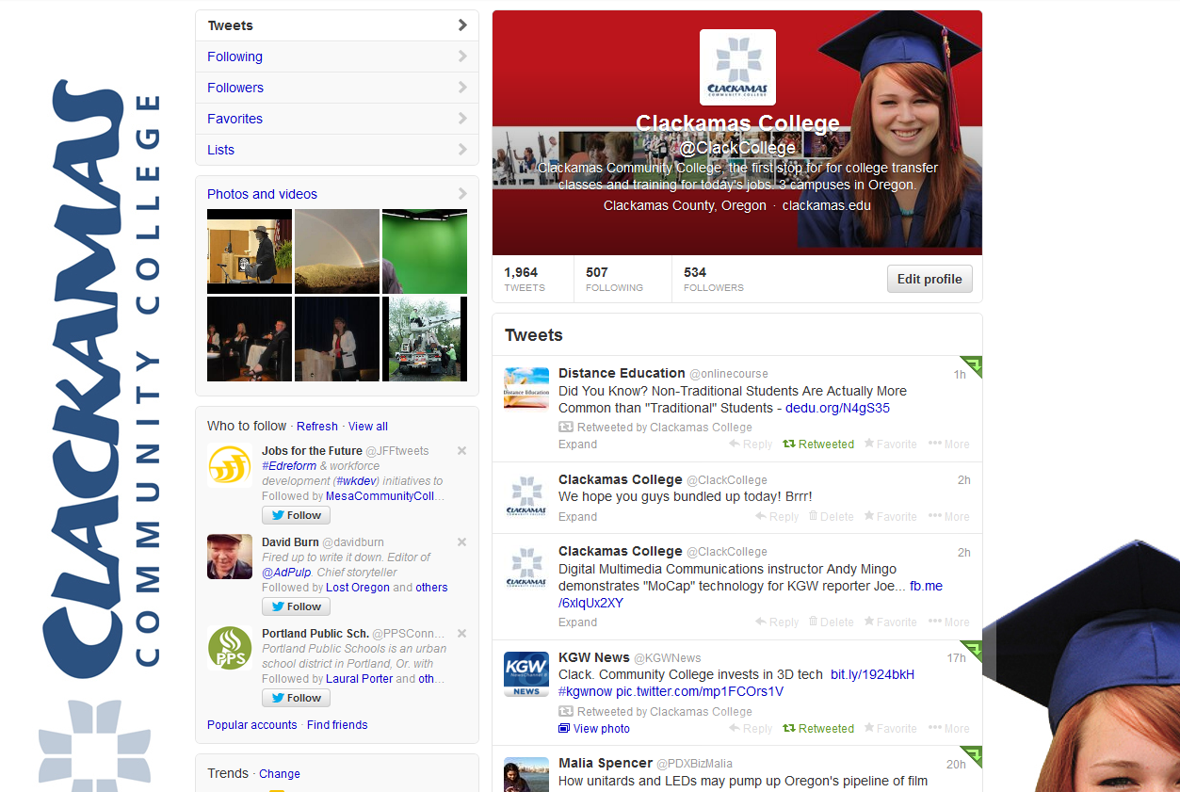
Social Media – Targeted Messages
Facebook
Twitter

Slide 10
CCC Home Page
http://www.clackamas.edu/default.aspx

Slide 11
Questions?

